Slide 1
STEGANOGRAPHIC TECHNIQUE FOR
24-BIT MAP IMAGES

Slide 2
Abstract:
Steganography is the process of hiding one file inside another such that others can neither identify its existence.
One of the most common methods of implementation is Least Significant Bit Insertion, in which the least significant bit of every byte is altered to form the bit-string representing the embedded file.
. Results indicate that the final technique has potential of being useful for privacy purposes.

Slide 3
OBJECTIVE:
The main objective of our project is to hide one image into another image.
Here we take two inputs i.e. cover image and the secret image

Slide 4
OVERVIEW:
Steganography & Its History
Steganography
LSB Technique
MATLAB
Graphical User Interface
Algorithm
Flow Chart
Application of steganography
Conclusion

Slide 5
HISTORY OF STEGANOGRAPHY:
Steganography comes from Greek and means “covered writing”. The ancient Greeks wrote text on wax-covered tablets.
To pass a hidden message, a person would scrape off the wax and write the message on the underlying wood.

Slide 6
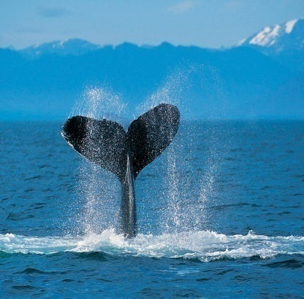
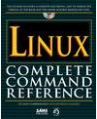
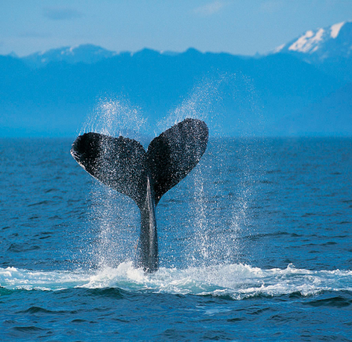
STEGANOGRAPHY
Hiding data inside a cover medium
Existence of any communication is undetectable.
Has an edge over cryptography, does not attract any
public attention.
Cover image: the image without any message embedded.
Stego image: the image with message embedded.
Cover Image
Hide Image
Stego Image

Slide 7
LSB INSERTION TECHNIQUE:
Most popular technique when dealing with images.
The simplest approach of hiding data within in an image file is called LSB insertion.
In this method ,we can take the binary representation of the hidden data and overwrite the LSB of each byte within the cover image.
The LSB insertion varies according to number of bits in an image.

Slide 8
LSB – EXAMPLE:
A sample raster data for 3 pixels (9 bytes)
may be:
Inserting
the binary
value for
A
(10000011)
changes
4 bits
00100111 11101001 11001000
00100111 11001000 11101001
11001000 00100111 11101011
00100111 11101000 11001000
00100110 11001000 11101000
11001001 00100111 11101011

Slide 9
LSB - USES
Storing passwords and/or other confidential information.
Cover communication of sensitive data.
Speculated uses in terrorist activities.
Being widely used to hide and/or transfer illegal content.

Slide 10
MATLAB
MATLAB is a high-level technical computing language for algorithm development, data analysis, and numeric computation.
MATLAB can solve technical computing problems faster than traditional programming languages, such as C, C++, and Fortran.
MATLAB is used in many applications like signal processing, image processing etc.

Slide 11
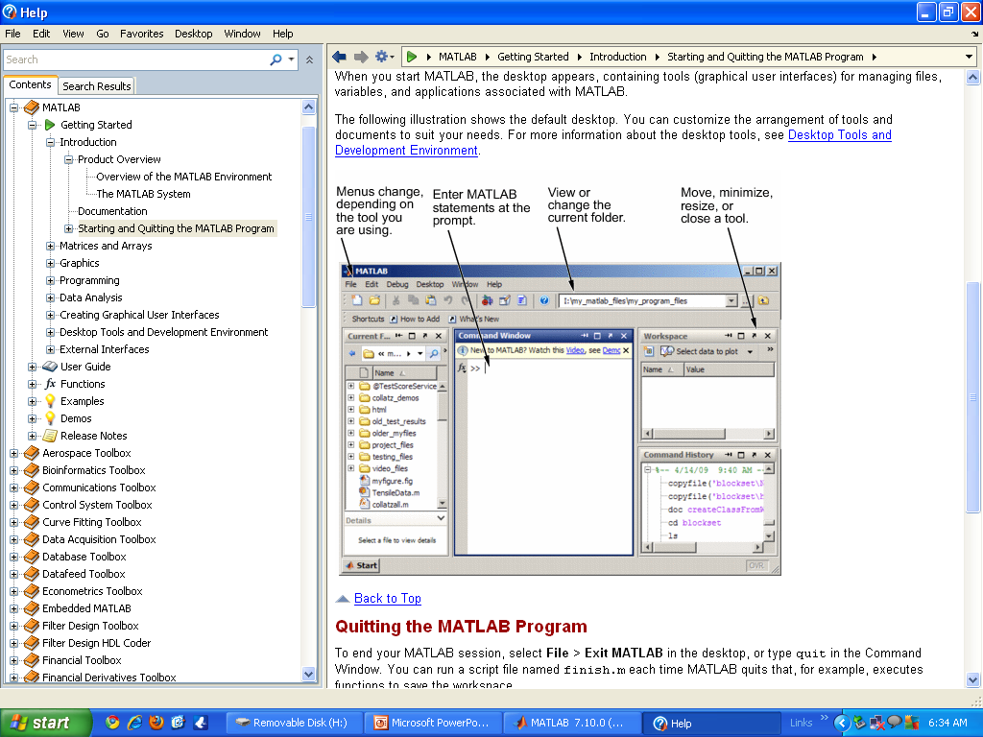
MATLAB Window Appears as:

Slide 12
IMAGE:
An image is represented as a two dimensional function f (x, y) where x and y are spatial co-ordinates.
The intersection point of this x and y co-ordinates is called the pixel.

Slide 13
MATLAB Commands Used:
imread (): To import an image from any supported graphics image file format, in any of the supported bit depths.
A = imread('football.jpg');
imwrite(): To export image data from the MATLAB workspace to a graphics file in one of the supported graphics file formats.
imwrite(A,‘xyz.jpg');
imshow(): To display image data.
imshow(A);

Slide 14
imfinfo(): Returns a structure whose fields contain information about an image in a graphics file.
imfinfo(‘football.jpg’);
bi2de(): Converts binary number to decimal number.
bi2de(‘010111’);
de2bi(): Converts decimal number to binary number.
de2bi(23);
bitget(): Returns bit at specified position.
bitget(A,bit);

Slide 15
uigetfile: Displays a modal dialog box that lists files in the current folder and enables you to select or enter the name of a file.
uigetfile({'*.m';'*.mdl';'*.mat';'*.*'},'File Selector');
uiputfile: Displays a modal dialog box for selecting or specifying a file you want to create or save.
uiputfile('animinit.m','Save file name');

Slide 16
Graphical User Interface:
It is a graphical display in one or more windows containing Controls, called components that enables a user to perform interactive tasks.
The GUI consists of
Menus
Toolbars
Push buttons
Radio buttons
some other components

Slide 17
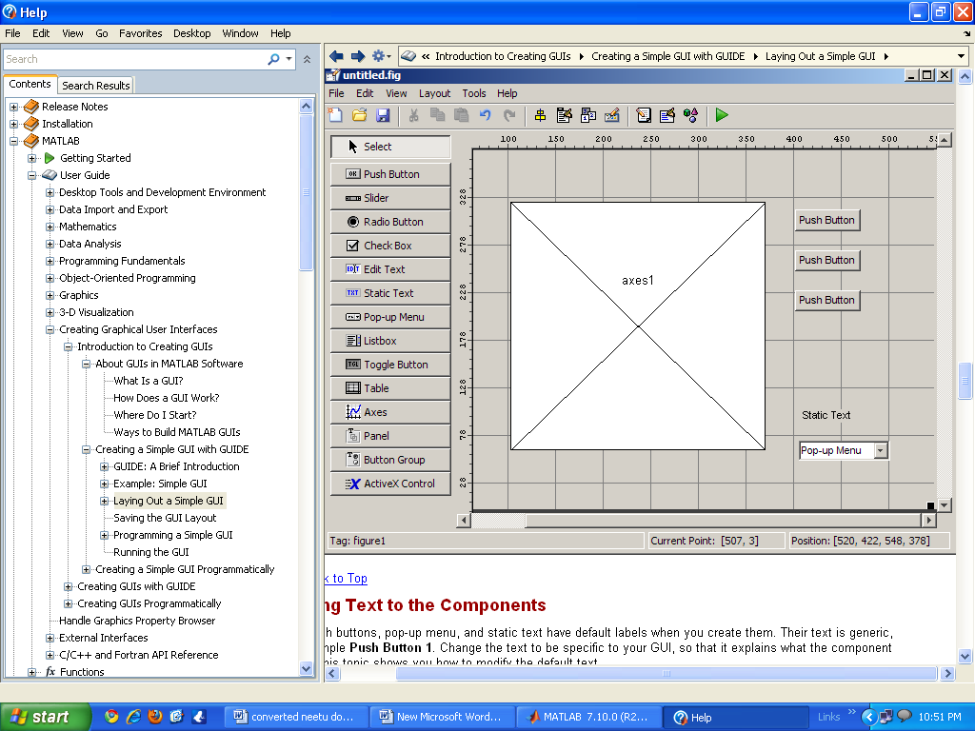
GUI Window Appears as:
6/7/12

Slide 18
ALGORITHM FOR EMBEDDING:
Read Cover Image into F.
Read Secret image or message into G.
Convert the images F and G into binary format using keyword de2bi.
Now take the each bit of a pixel from G and store it in the LSB of F.
Now convert the binary values of the resulting image (Stego-image) to decimal using keyword bi2de.
Finally the stego image is formed i.e. the secret image is hidden in cover image.

Slide 19
ALGORITHM FOR EXTRACTION:
Read the Stego - Image into F.
Convert F into binary values using keyword de2bi.
Take the LSB of each pixel, and append these bits depending on the depth of the secret message to form pixels of the Secret image.
Convert this into Decimal using keyword bi2de.
Finally the secret image is again retrieved back.

Slide 20
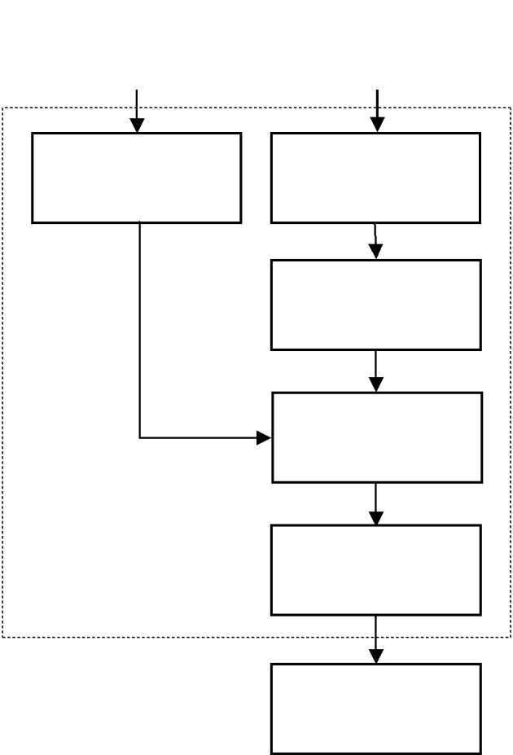
Flow Chart: I
Image to hide
Cover image
File compression
Color selection
Pixel filtering
Bit replacement
LSB matching
Steganographic image
Formation of a stego image

Slide 21
Flow Chart: II
Stego image
Color selection
Pixel filtering
Bit replacement
Hidden image
Extraction of a stego image

Slide 22
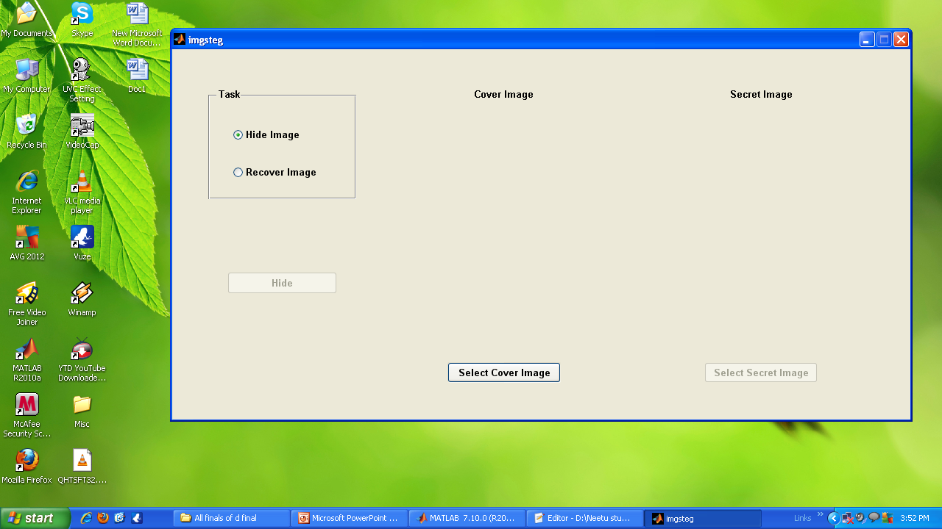
Final GUI Window Appears as:
6/7/12

Slide 23
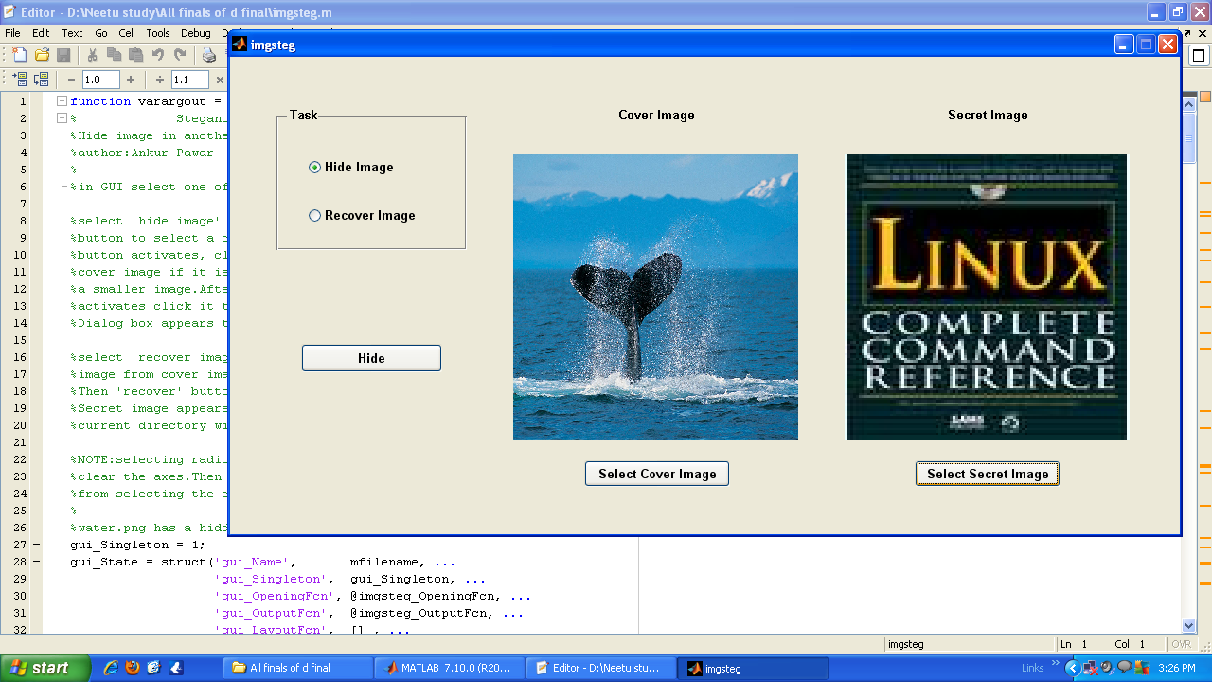
While Hiding An Image:

Slide 24
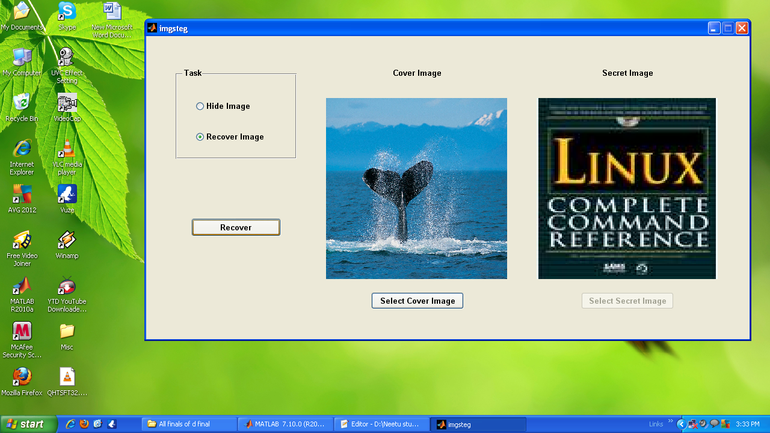
After Recovering The Image:

Slide 25
APPLICATIONS OF STEGANOGRAPHY:
Steganography has wide range of applications:
Watermarking purpose
Security purpose in paychecks
Steganography existence in any communication is undetectable

Slide 26
CONCLUSION:
Steganography can be used as beneficial tool for privacy.
Existence of any communication inside cover medium is undetectable.
For hiding data steganography is one of the mostly used technique.

Slide 27
REFERENCES
1.Digital Image Processing using MATLAB by Gonzalez woods.
2.N.Provos and P.Honeyman,”Hide and seek:An introduction to stegnography.
3.R.J.Anderson and Penticolas ,F. A. P., ” On the limits of steganography”.
4.Curran,K.and Bailey, K. ” An evaluation of image based stegnography method”.

Slide 28
ANY QUIERIES?

Slide 29
THANK YOU

